Slide 1
MX2020 Big Data
GCG Mexico – Architecture Even Hub SourceConnector (Messaging)
June 05, 2019

Slide 2
Versión | Fecha | Descripción del Cambio | Autor/Departamento
1.0 | 10/07/2019 | Creación del documento | [Big Data Architecture]

Slide 3
MX2020 Big Data
Table of Contents
Purpose of the document
Functional analysis
Graphic Representation of Architecture
General services
References and Annexes

Slide 4
Definición del documento
Purpose
The purpose of this document is to graphically represent the proposed technical solution of Event Hub.
The principles of architecture that are served:
Separation of responsibilities at the component level, without losing the essence of an Even Hub that is the integration with the dispersed systems, in order to obtain the latest events (data), generate transformations that give value to business in near real time.
Build real-time data pipes and transmission applications. Integrate data from multiple sources and locations into a single central event transmission platform of Citibanamex.
Simplify the connection of data sources to Kafka, and generate a common component.
Scope
Define a common structure to multiple sources, projecting a solution as a service

Slide 5
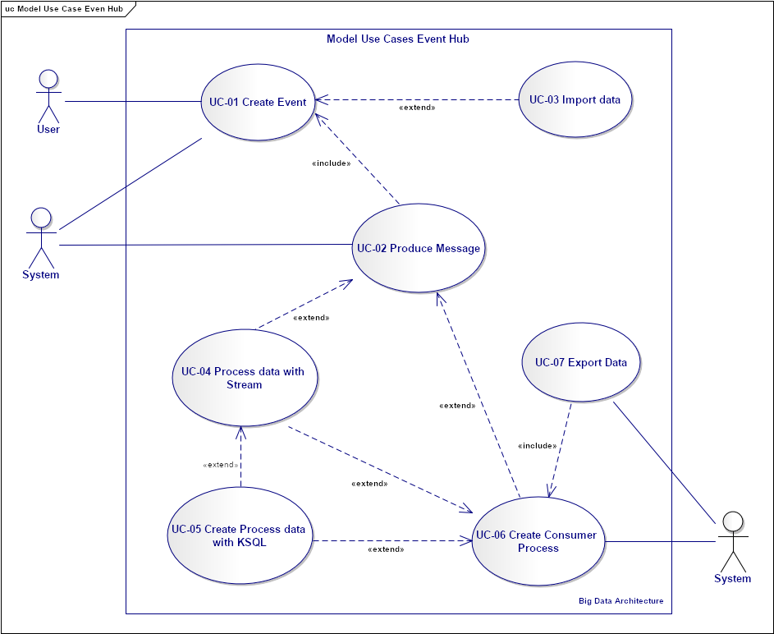
Even Hub
Functional analysis – Model Use Case Event Hub
The following diagram describes the objectives of the users, the interactions between the users and the system, and the required behavior of the system to satisfy the functionalities.
CU-01 Create Event
CU-02 Import data
CU-03 Produce Message
CU-04 Process data with Stream
CU-05 Process data with KSQL
CU-06 Create Consumer Process

Slide 6
Even Hub
Functional analysis – Use Case 01 Create Event
CU-01 Create Event – Description

Slide 7
Even Hub
Functional analysis – Use Case 02 Import data
CU-03 Create Event – Description

Slide 8
Even Hub
Functional analysis – Use Case 03 Create Produce Message
CU-03 Produce Message - The producer creates new messages. The producer will direct the messages to specific partitions. This is done using the message key and a partitioner that will generate a hash of the key and assign it to a specific partition. This ensures that all messages produced with a given key will be written to the same partition.

Slide 9
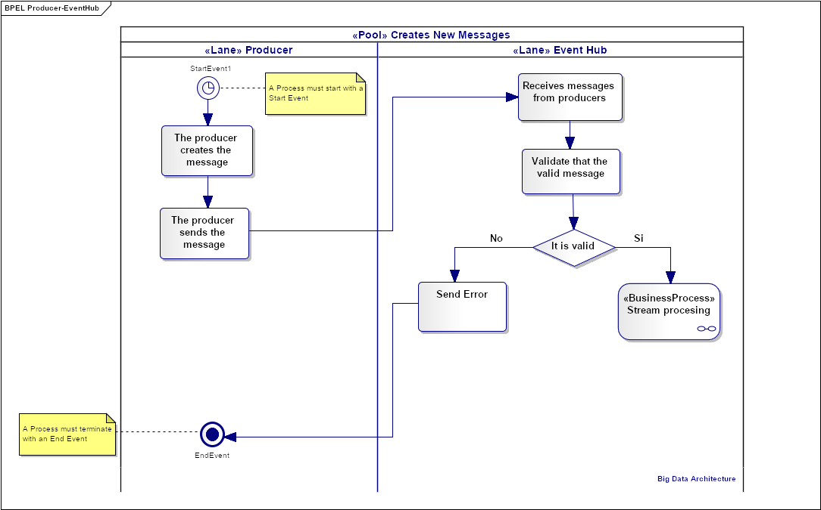
Even Hub
Functional analysis – Flow of Use Case Produce Message
Describe the logic of the steps in a Produce Message use case process.
A call is made to the flow of Stream processing.

Slide 10
Even Hub
Functional analysis – CU-04 Process data with Steam API
CU-04 Process data with Steam API -

Slide 11
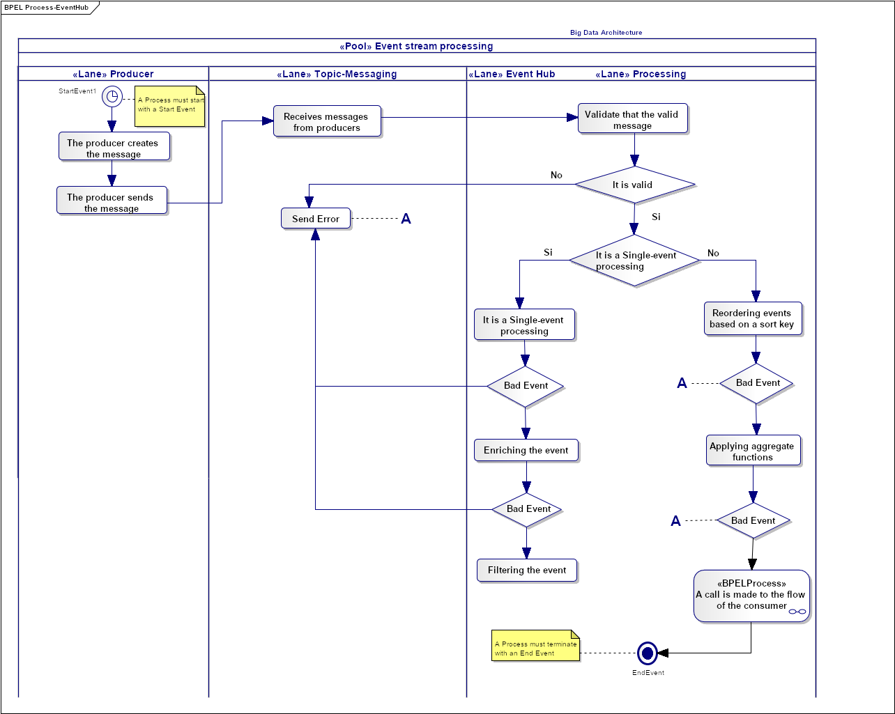
Even Hub
Functional analysis – Flow of Use Case Process data with Stream
Describe the activities of the use case of Process Message.
A call is made to the flow of the consumer

Slide 12
Even Hub
{"schema": {"type": "struct","fields":
[{"type": "int64", "optional": false, "field": "CustumerNumber"},
{"type": "int32", "optional": false, "field": "BusinessId"},
{"type": "int32", "optional": false, "field": "CountryId"},
{"type": "int64", "optional": false, "field": "InputMessageId"},
{"type": "TIMESTAMP", "optional": false, "field": "ProcessDate"},
{"type": "int32", "optional": false, "field": "CommunictionType"},
{"type": "int32", "optional": false, "field": "EventId"},
{"type": "int32", "optional": false, "field": "ProductId"},
{"type": "int64", "optional": false, "field": "AccountNumber"},
{"type": "string", "optional": false, "field": "Amount"},
{"type": "int64", "optional": false, "field": "AuthorizationNumber"},
{"type": "string", "optional": false, "field": "MerchantName"},
{"type": "string", "optional": false, "field": "CustumerName"},
{"type": "int32", "optional": false, "field": "RepId"},
{"type": "string", "optional": false, "field": "RepName"},
{"type": "string", "optional": false, "field": "ChannelId"},
{"type": "string", "optional": false, "field": "ChannelValue"},
{"type": "int64", "optional": false, "field": "AlertValue"},
{"type": "int32", "optional": false, "field": "TemplateId"},
{"type": "string", "optional": false, "field": "CommunicationContent"},
{"type": "string", "optional": false, "field": "ProcessStatus"},
{"type": "string", "optional": false, "field": "ErrorMessage"}],
"optional": false, "name": "ksql.messaging},
"payload": {
"CustumerNumber": 20741677,
"BusinessId": 01,
CountryId: MX,
InputMessageId: MX010087A201905241354261324,
ProcessDate: 24-052019 13:54:26,
CommunictionType: A,
EventId: 101,
ProductId: 103,
AccountNumber: 5634250213811694,
Amount: +55555555555.55,
AuthorizationNumber: 12345678,
MerchantName: Starbucks Portal San Angel,
CustumerName: AGUILR,ARREDONDO/ANTONIO,
RepId: 99,
RepName: Antonio Aguilar Arredondo,
ChannerlId: EMAIL,
AlertValue: armando.antonio.aguilar@gmail.com,
TemplateId: 37,
CommunicationContent: Deposito CUENTA PERFILES M.N. 760 monto $2000.00 el 18/05/19 02:46:00 PM. En operaciones con cheque valida tu saldo antes de realizar cualquier operación.,
ProcessStatus: Error,
ErrorMessage: Importe inferior al monto mínimo}}
Functional analysis – Event modeling
CustumerNumber | 20741677
BusinessId | 01
CountryId | MX
InputMessageId | MX010087A201905241354261324
ProcessDate | 24-052019 13:54:26
CommunictionType | A
EventId | 101
ProductId | 103
AccountNumber | 5634250213811694
Amount | +55555555555.55
AuthorizationNumber | 12345678
MerchantName | Starbucks Portal San Angel
CustumerName | AGUILR,ARREDONDO/ANTONIO
RepId | 99
RepName | Antonio Aguilar Arredondo
ChannerlId | EMAIL
AlertValue | armando.antonio.aguilar@gmail.com
TemplateId | 37
CommunicationContent | Deposito CUENTA PERFILES M.N. 760 monto $2000.00 el 18/05/19 02:46:00 PM. En operaciones con cheque valida tu saldo antes de realizar cualquier operación.
ProcessStatus | Error
ErrorMessage | Importe inferior al monto mínimo
The structure contains fields other than schema and payload, which is the envelope structure used by the JsonConverter with schemas.enable=true (the default).

Slide 13
Even Hub
Global Architecture – Graph (topology) of the Massaging App
KEY = ConsumerId
Aggregate by Key
Serialize/
Deserialize
Output Topic: JSON
Validate Massage
Branch
Input Topic: JSON
Send Error
Local State

Slide 14
Event Hub
Functional analysis – Multiple-event processing
For the processing of the transmission it is visualized that the multiple events of a client are given the task of reading and processing the information presented in the following scenario, to generate a type of output.
Use Aggregating
Pattern matching
Sorting
Aggregation app
Update by key Event
Θ1
Θ2
Θ3
Θ4
Θ5
Θ6
Θ7
Θ8
looking for patterns
Pattern matching app
Reordering events based on a sort key
Sorting app

Slide 15
Event Hub
Functional analysis – Streams and state
We contemplate the use of state to Streams Processing, to follow up each client updated the status of the mail. The consumer verifies the client's status and sends the results to the Data Lake.
KStream.transformValues, will allow us to have states in the processes.
"CustumerNumber": 20741677,
"BusinessId": 01,
CountryId: MX,
InputMessageId: MX010087A201905241354261324,
ProcessDate: 24-052019 13:54:26,
CommunictionType: A,
EventId: 101,
ProductId: 103,
AccountNumber: 5634250213811694,
Amount: +55555555555.55,
AuthorizationNumber: 12345678,
MerchantName: Starbucks Portal San Angel,
CustumerName: AGUILR,ARREDONDO/ANTONIO,
RepId: 99,
RepName: Antonio Aguilar Arredondo,
ChannerlId: EMAIL,
AlertValue: armando.antonio.aguilar@gmail.com,
TemplateId: 37,
CommunicationContent: Deposito CUENTA PERFILES M.N. 760 monto $2000.00 el 18/05/19 02:46:00 PM. En operaciones con cheque valida tu saldo antes de realizar cualquier operación.,
ProcessStatus: Error,
ErrorMessage: Importe inferior al monto mínimo
In-Memory
Key/value store
tranformValuesprocessor
"CustumerNumber": 20741677,
"BusinessId": 01,
CountryId: MX,
InputMessageId: MX010087A201905241354261324,
ProcessDate: 24-052019 13:54:26,
CommunictionType: A,
EventId: 101,
ProductId: 103,
AccountNumber: 5634250213811694,
Amount: +55555555555.55,
AuthorizationNumber: 12345678,
MerchantName: Starbucks Portal San Angel,
CustumerName: AGUILR,ARREDONDO/ANTONIO,
RepId: 99,
RepName: Antonio Aguilar Arredondo,
ChannerlId: EMAIL,
AlertValue: armando.antonio.aguilar@gmail.com,
TemplateId: 37,
CommunicationContent: Deposito CUENTA PERFILES M.N. 760 monto $2000.00 el 18/05/19 02:46:00 PM. En operaciones con cheque valida tu saldo antes de realizar cualquier operación.,
ProcessStatus: successful,
ErrorMessage: Importe inferior al monto mínimo
trasformationValuesprocesor uses local state to perform transformation

Slide 16
Needs and Solution Proposal
Event Hub Architecture – Integration Patterns
Event Producer
Event Hub
Event Consumer
Event Producer
Stream App
Stream App
A
Stream App
A
Kafka Custom API Source
Eclipse CRP
B
MQ/JMS/Kafka Custom API Source
B
Solace/Kafka Custom API Source
ATM´s
Kafka Connect Cluster – Worker 3
Kafka Cluster
(Brokers, Zookeeper)
Kafka Connect Cluster – worker 3
C
Name Events (Topic)
JDBC/ Kafka Custom API Source
Alertas
C
Kafka Connect Cluster – Worker 2
Kafka Cluster
(Brokers, Zookeeper)
Kafka Connect Cluster – worker 2
D
Name Events (Topic)
Name Events (Topic)
Name Events (Topic)
A
Name Events (Topic)
EMS/ Kafka Custom API Source
Name Events (Topic)
CAP
E
Kafka Connect Cluster – Worker 1
Kafka Cluster
(Brokers, Zookeeper)
Kafka Connect Cluster – worker 1
COP
D
Name Events (Topic)
Name Events (Topic)
Name Events (Topic)
Name Events (Topic)
Name Events (Topic)
Data Capture
Name Events (Topic)
Name Events (Topic)
B
F
Name Events (Topic)
TECOS
Name Events (Topic)
Abinitio ETL
E
Name Events (Topic)
Name Events (Topic)
G
TIBCO
Connector 1
Task 1
Name Events (Topic)
Connector 1
Task 1
Name Events (Topic)
Name Events (Topic)
Name Events (Topic)
Name Events (Topic)
Event Consumer
Name Events (Topic)
C
EAP
F
Name Events (Topic)
Name Events (Topic)
Name Events (Topic)
IBM
Name Events (Topic)
Connector 3
Task 1
Name Events (Topic)
Name Events (Topic)
Connector 3
Task 1
Name Events (Topic)
Name Events (Topic)
A
JDBC/Kafka Connector Source
Name Events (Topic)
Kafka Connect
Sink
D
F
Name Events (Topic)
Mongo
Oracle
Name Events (Topic)
Kafka Custom API Sink
Name Events (Topic)
Name Events (Topic)
Name Events (Topic)
Name Events (Topic)
Name Events (Topic)
B
Connector 2
Task 2
Name Events (Topic)
Name Events (Topic)
Connector 2
Task 2
HDFS/Hive/Kafka Custom API Sink
F
Name Events (Topic)
E
Engine Evaluator
C
Tandem
Name Events (Topic)
Name Events (Topic)
AbInitio ETL
Name Events (Topic)
Name Events (Topic)
Name Events (Topic)
D
Abinitio ETL
Data Capture
Connector 3
Task 1
Name Events (Topic)
Connector 3
Task 1
Name Events (Topic)
Name Events (Topic)
Name Events (Topic)
Name Events (Topic)
Name Events (Topic)
Unisys
G
Name Events (Topic)
Name Events (Topic)
AbInitio
ETL

Slide 17
Event Hub
Componente nuevo
Componente a modificar
Global Architecture As A Service
Componente no contemplado
Third phase
Client
Client
Client
Client
Client
Client
<< uses >>
<< uses >>
Second phase
ProducerService
ConsumerService
<< uses >>
<< uses >>
System
Target System
System
System
System
<< send>>
citiProducerEngine
<< use>>
Kafka
Broker
<< use>>
citiConsumerEngie
<< send>>
System
System Source
System
<< use>>
<< use>>
<< deploy>>
cmpCitiAccessSink
<< connect>>
<< connect>>
<< use>>
<< use>>
cmpCitiProcessStream
cmpCitiAccessSources
cmpCitiCommandKafka
cmpCitiSecurity
First phase
<< use>>

Slide 18
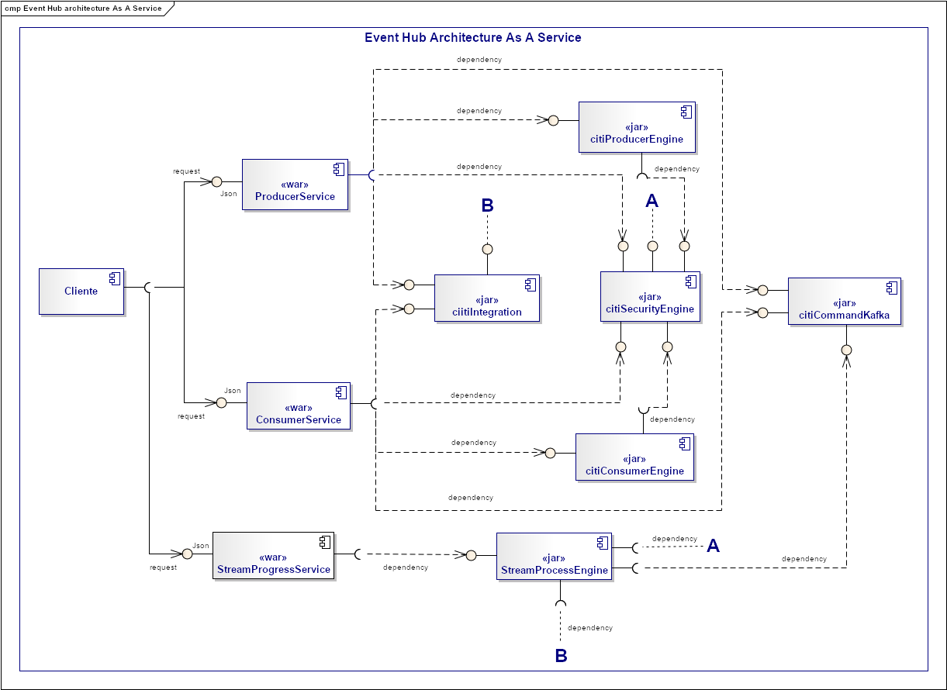
Event Hub
Componente nuevo
Componente a modificar
Global Architecture
Componente no contemplado

Slide 19
Even Hub
Global Architecture - The steps of the architecture for the processing engine
Read the individual events of a Kafka theme (input messages)
Validate the message and send any defective event to a topic dedicated to Kafka called invalid messages
Write the enriched messages in a Kafka theme called valid messages
Input-messages
r1
r2
r3
r4
r5
r6
Processing Engine
Valid-messages
READ
Validation
Enrichment
WRITE
v1
v2
v3
v4
v5
v6
WRITE
invalid-messages
i1
i2
i3
i4
i5
i6

Slide 20
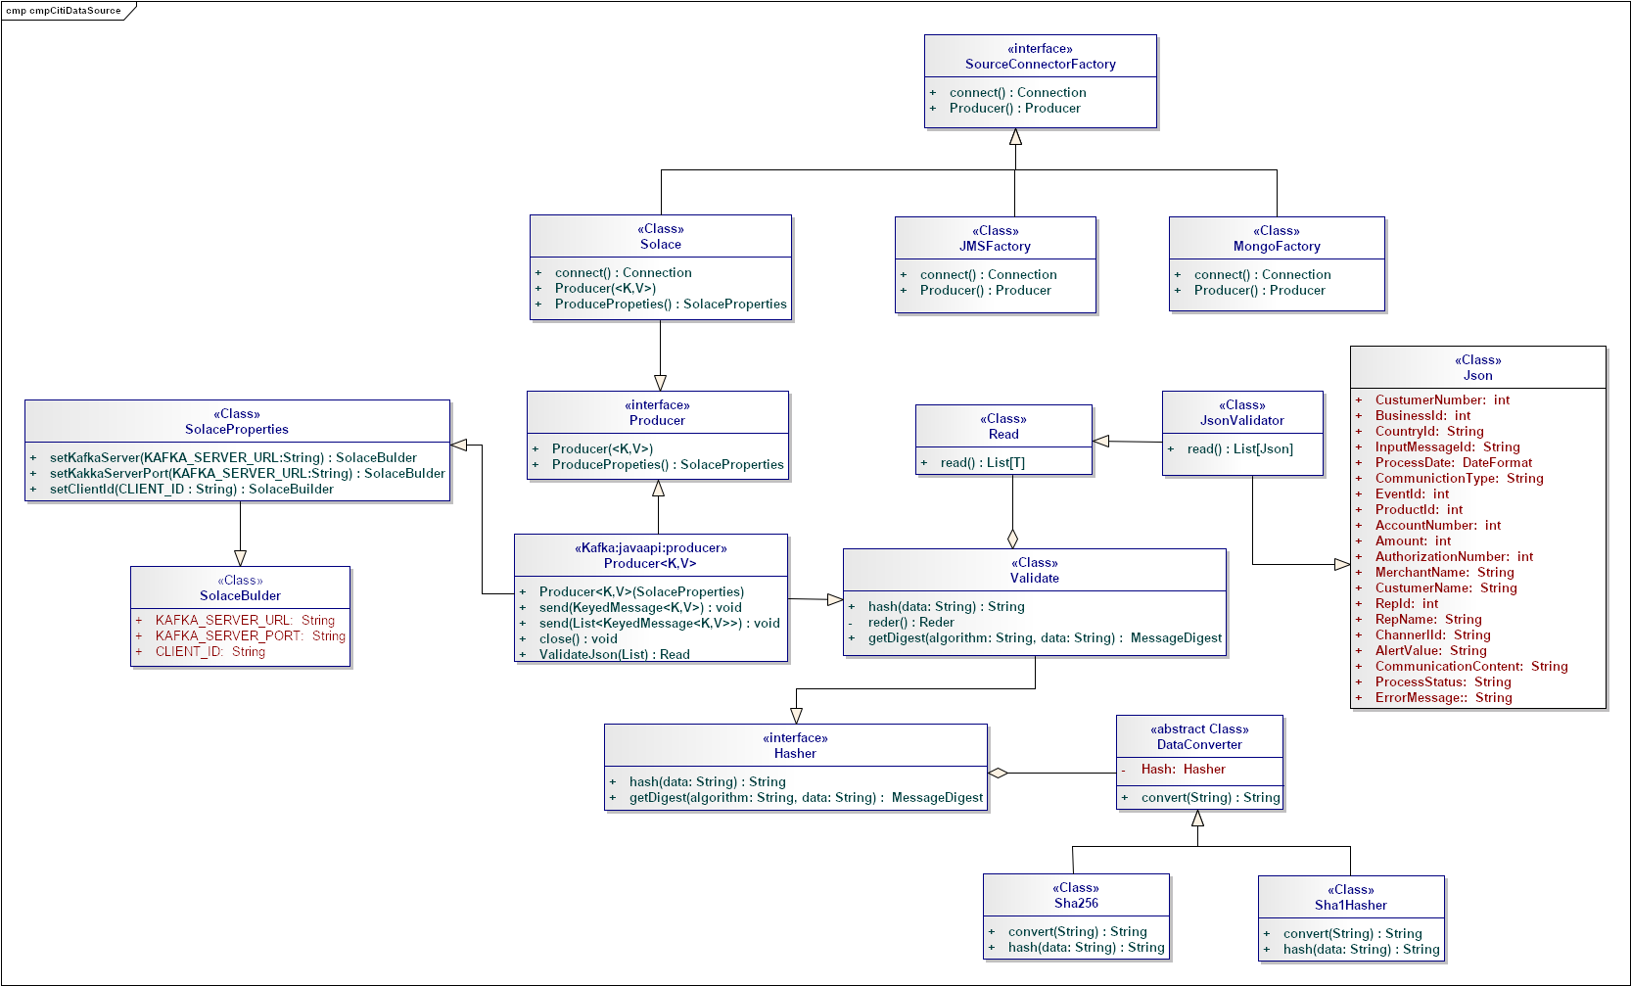
Even Hub
Architecture Internal Structure Of citiIntegration (Source)

Slide 21
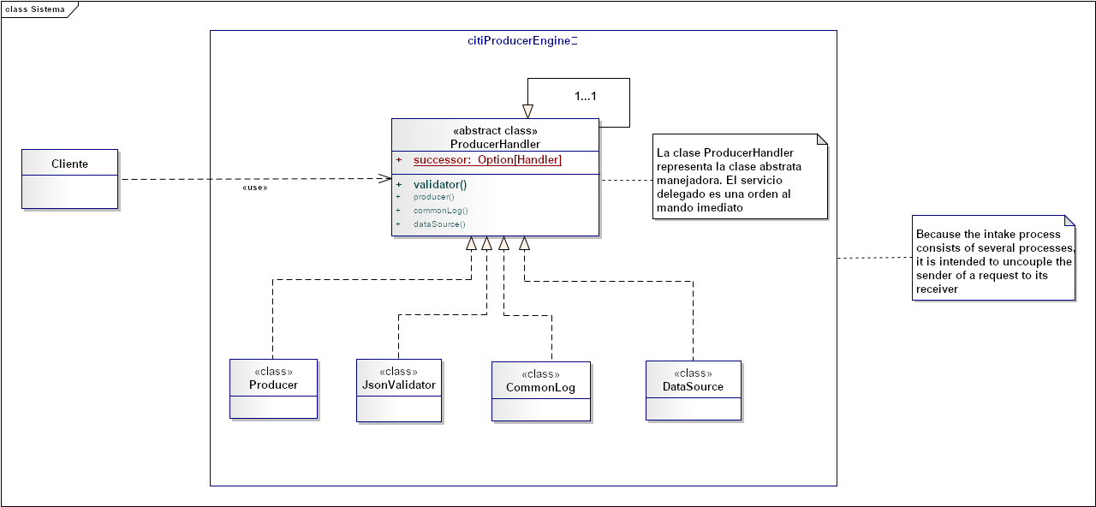
Event Hub
Architecture Internal Structure Of citiProducerEngine

Slide 22






Event Hub
Global Architecture
<< uses >>
StreamProcessEngine
ConsumerService
Kafka REST Proxy)
<< uses >>
B
Tibco
ProducerService
(Kafka REST Proxy)
Kafka Cluster (Brokers, Zookeeper)
Serving Layer
Kafka Cluster (Brokers, Zookeeper)
<< uses >>
A
Solace
StreamProgressService
Kafka REST Proxy)
Name Events (Topic)
Kafka Cluster (Brokers, Zookeeper)
Stream APIs
Name Events (Topic)
Kafka Connect
Sources
Name Events (Topic)
Kafka Connect
Sink
Search
3.
Name Events (Topic)
Indexed for Search
<< uses >>
Name Events (Topic)
Name Events (Topic)
<< uses >>
Key Value Storage
ciitiIntegration
(Source)
4.
Name Events (Topic)
Name Events (Topic)
Business Intelligence
Name Events (Topic)
ciitiIntegration
(Sink)
<< uses >>
Name Events (Topic)
COP
5.
CitiProducerEngine
Name Events (Topic)
Name Events (Topic)
<< uses >>
Name Events (Topic)
<< uses >>
Name Events (Topic)
Newsfeed
Name Events (Topic)
citiConsumerEngine
B
Data Bases
6.
cmpComandKafka
Name Events (Topic)
Name Events (Topic)
Name Events (Topic)
OLAP
7.
Name Events (Topic)
Cognitive
citiSecurityEngine
Name Events (Topic)
S3
Log aggregation
Name Events (Topic)
n…
A
<< uses >>

Slide 23
Big Data Process
Agile and DevOps
Continuous Delivery / Deployment (CD)
Code
Build
Integrate
Test
Release
Deploy
Operate
Agile Development
Continuous Integration
Continuous Delivery
Continuous Delivery
DevOps

Slide 24










Big Data Process
Agile and DevOps
Integration and continuous deployment
Pull
Download & Test
Test Automation
Source code repository
Binary repository
Deploy
Download & Deploy
Push
{Dev}
Compilation tool
Developer
Package & Test
Task Orchestrator
Even Hub Citi
or
Analyze
static code analysis
RML

